Slide 1


Memory Hierarchy Session No.: 27 Course Name: Computer Organisation and Architecture Course Code: R1UC305T Instructor Name: Dr. Manish Verma Duration: 50 min. Date of Conduction of Class: as per Session Plan

Slide 2
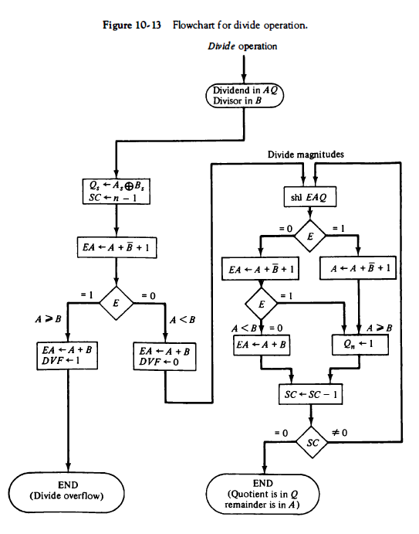
key concepts of session no. 27
Division Algorithms
(Restoring and Non-Restoring)

Slide 3
Pre-session activities
Wooclap

Slide 4
👉 “When you browse the internet on your phone, why do some pages open instantly while others take time?”
Opening Question

Slide 5
At the end of this session students will be able to
Learning Outcome 1: Explain the concept of memory hierarchy
Learning Outcome 2: Identify Different level of memory hierarchy

Slide 6
Session Outline
Introduction
Activity-1
Cache Memory
Main Memory
Auxiliary Memory

Slide 7
Introduction
A single memory unit is not enough for computers
CPU is faster than memory → mismatch reduces performance
Solution → Memory Hierarchy (multiple levels of memory)
CPU ↔ Cache ↔ Main Memory ↔ Disk ↔ Tape

Slide 8
Learning Activity 1: paper-pen/WooClap
Arrange the following in order of:
(a) Speed
(b) Capacity
(c) Cost per bit
Memory Types: Cache, Main Memory, Magnetic Disk, Tape

Slide 9
Cache Memory
Small, very fast memory close to CPU
Stores frequently used instructions/data
Access time: ~100 ns vs RAM 700 ns
Example: L1, L2, L3 cache in modern processors

Slide 10
Main Memory
RAM → CPU’s working memory (volatile)
Medium speed, moderate cost
Stores programs/data currently in use
Example: Laptop/PC RAM

Slide 11
Auxiliary Memory
Includes Hard Disk, SSD, Magnetic Tapes
Huge capacity, low cost
Slow access compared to Cache/RAM
Used for permanent storage & backups

Slide 12
Learning Activity 2: THINK-PAIR SHARE
Question: Why don’t we design computers using only Cache memory?
Think → Pair with partner → Share answer

Slide 13
Reflection

Slide 14
Summary
Memory hierarchy balances speed, cost, and capacity
Cache: fastest but small & expensive
Main Memory: moderate size & speed
Auxiliary: very large, slow, cheap

Slide 15
Ensure attainment of LOs in alignment to the learning activities: outcomes (1-2)
Outcome 1: Understand the concept of memory hierarchy
Outcome 2: Grasp the knowledge about Different level of memory hierarchy

Slide 16
Post-session activities
Wooclap

Slide 17
Information about the next lesson
Main Memory

Slide 18
Review and Reflection from students
Question: What is one new thing you learned about memory hierarchy today?

